Slide 1


Data Visualization of Airport Traffic
A PROJECT PRESENTATION
BY
Daniel Andepu

Slide 2

01 - Introduction
02 - History
03 - Data Visualization
04 - Conclusions
Data
Visualization

Slide 3
01 - Introduction
ANALYZING DATA ENABLES INFORMED DECISION-MAKING
Objective: "To analyze the air traffic data to identify busiest airports, total monthly and yearly flights, and provide predictive insights for air traffic in the U.S."
Methods: List methods used such as data cleaning, analysis in Python, and visualizations in Power BI.
Train a model to predict the Busyness of a given particular Airport on a given Day.
Data

Slide 4
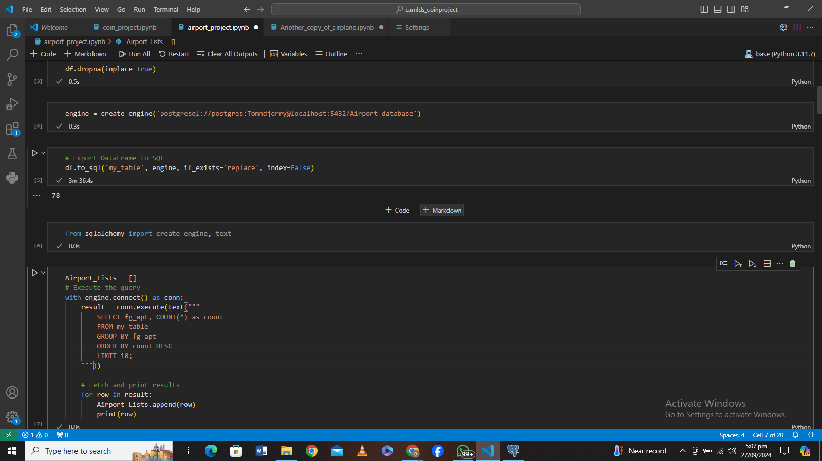
Code: Exporting DF to SQL

Slide 5
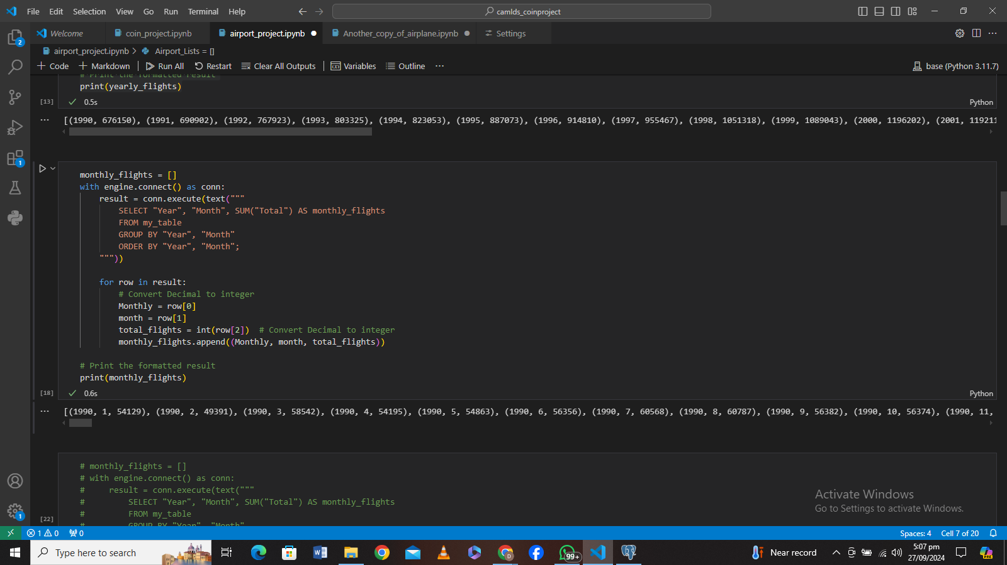
Code: SQL Quarries

Slide 6

Code: Python Visualisation

Slide 7
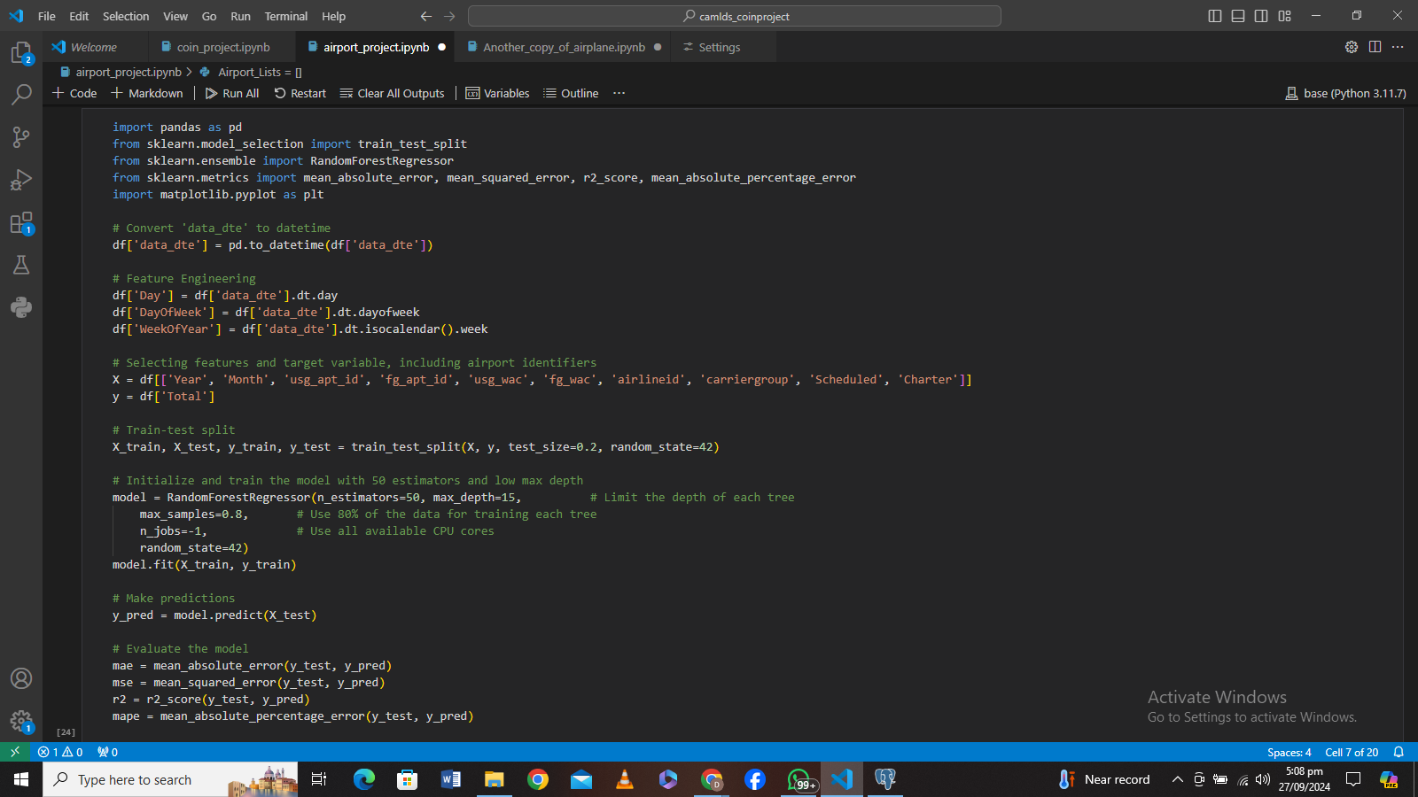
Code: Model Training 1

Slide 8
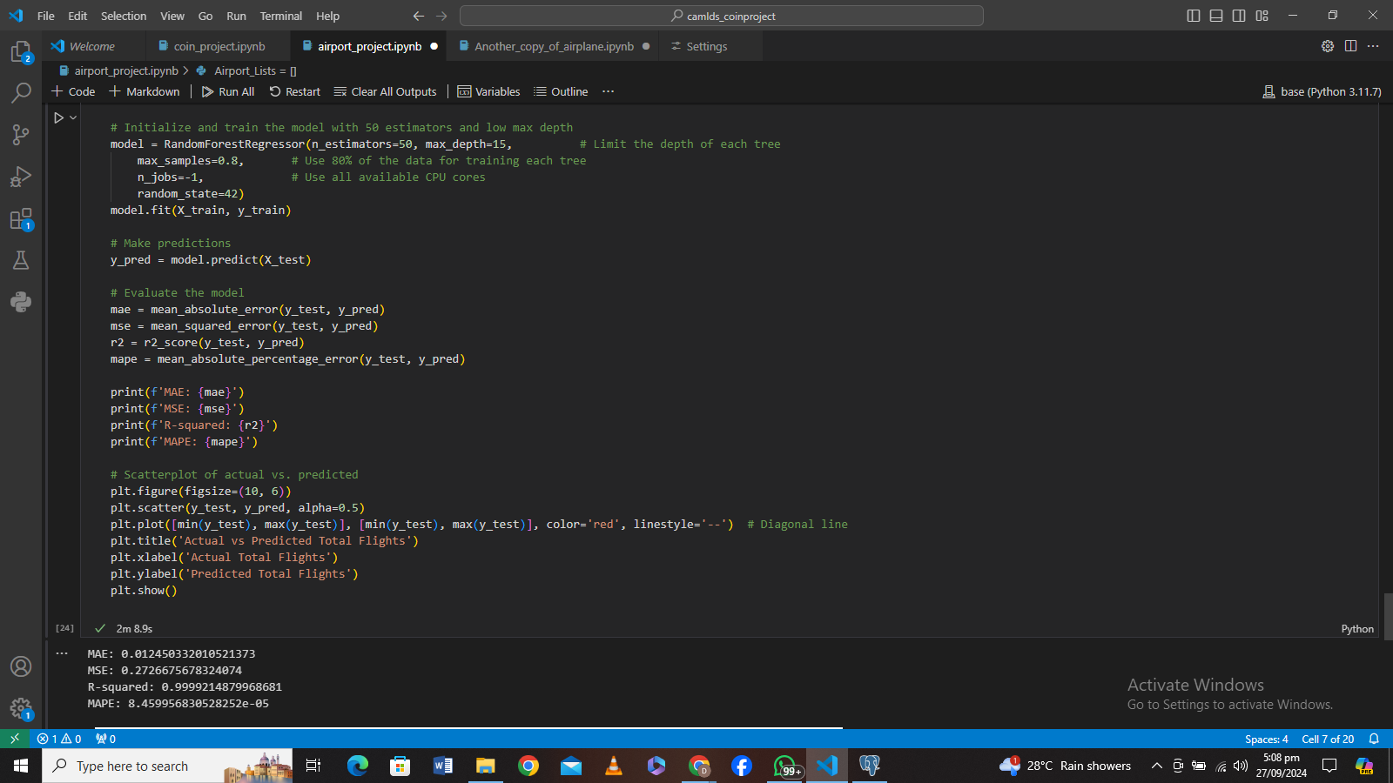
Code: Model Training 2

Slide 9
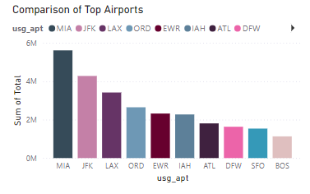
VISUALIZATION: BAR CHART OR TABLE SHOWING THE TOP 10 BUSIEST AIRPORTS BY NUMBER OF FLIGHTS
MIA - Miami International Airport: 5,514,194 flights
JFK - John F. Kennedy International Airport: 4,191,210 flights
LAX - Los Angeles International Airport: 3,353,486 flights
ORD - O'Hare International Airport (Chicago): 2,604,476 flights
EWR - Newark Liberty International Airport: 2,273,128 flights
IAH - George Bush Intercontinental Airport (Houston): 2,231,377 flights
ATL - Hartsfield-Jackson Atlanta International Airport: 1,769,838 flights
DFW - Dallas/Fort Worth International Airport: 1,594,373 flights
SFO - San Francisco International Airport: 1,500,638 flights
BOS - Logan International Airport (Boston): 1,108,902 flights

Slide 10

History of the Data
THE DATA WAS GOTTEN FROM
HTTPS://DATA.TRANSPORTATION.GOV/AVIATION/INTERNATIONAL_REPORT_DEPARTURES/INNC-GBGC/ABOUT_DATA

Slide 11

History
The website Is controlled by the U.S Department of transport Department of Transportation Office of the Assistant Secretary for Aviation and International Affairs.
All nonstop commercial departures operating between international points and U.S. airports.

Slide 12
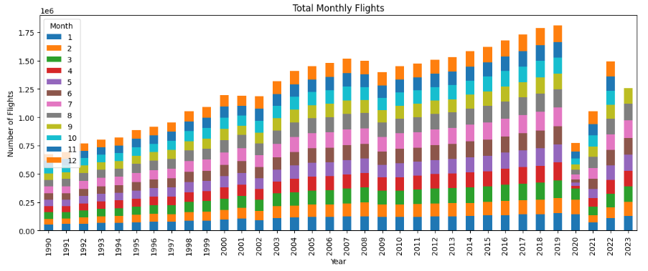
03 - Data Visualization- By Month
Visualization

Slide 13
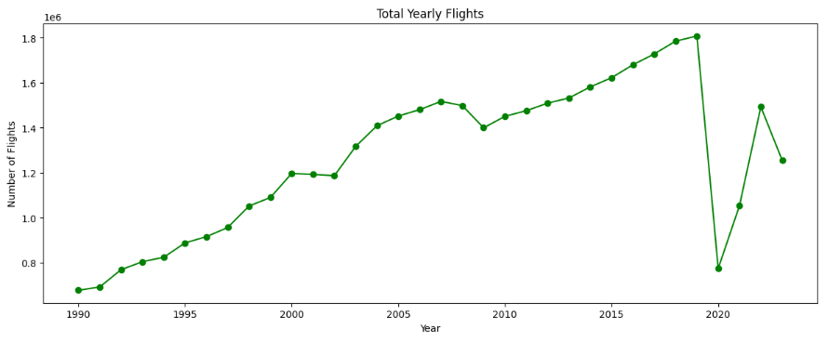
Data Visualization- By Month
Visualization

Slide 14
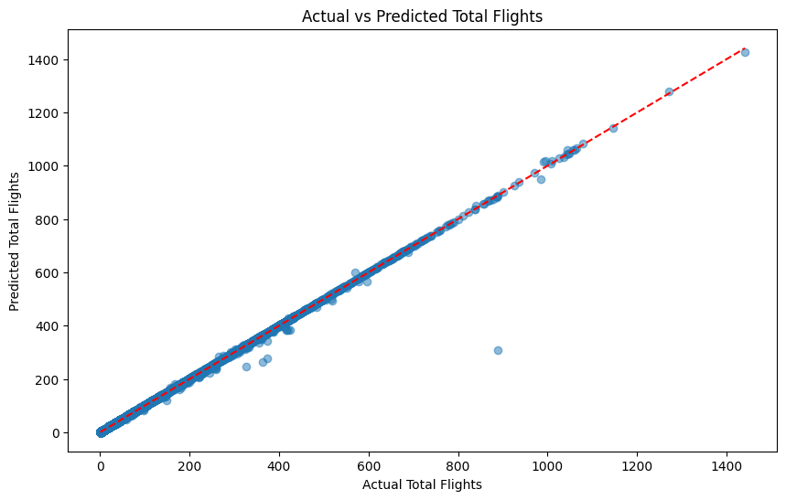
04 - Data Modeling
VISUALIZATION
The Model was trained to predict the total daily air traffic in the United States.
The model Used a Random Forest Regressor with the RegPlot shown.

Slide 15

04 - Data Modeling
These are the Performance Metrics.
The model showed a very High level of accuracy based on the Test set given to the model.

Slide 16
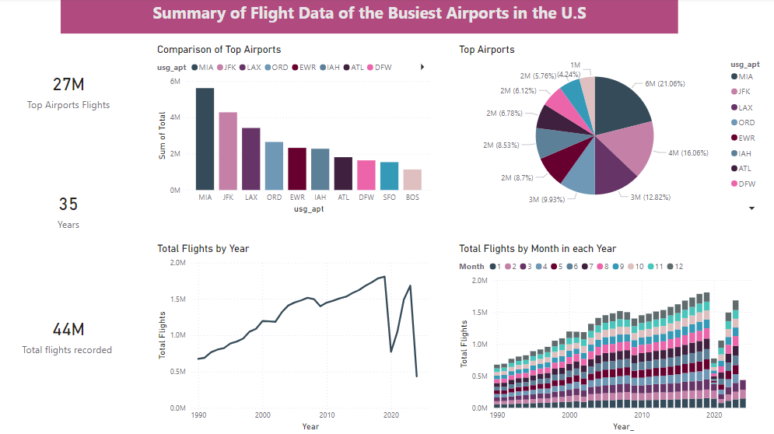
Power BI Dashboard

Slide 17

From the Data Shown.
The Years with the most flights and the least flights were 2019 and 2020 respectively.
The Aviation industry grew continuously over the years up until 2020 where there was a drastic drop due to COVID 19.
After this period the industry picked up again and has since then continued to grow.
INSIGHT
04 - Conclusions

Slide 18

Thanks
Daniel Andepu

